Slide 1
DATA 460 – Final Visualization Project
By:
Prajwal Nagaraj
Aditya Kumar Shrivastav
Rajkamal Kaur Saran

Slide 2
AGENDA
Introduction
Company and Data Sets
Goal
Business Understanding
Data Conceptual Model
Data Dictionary
Data Understanding
Data Preparation
Business Questions
Summary Recommendations and References

Slide 3
INTRODUCTION
In this study, we analyze the Canadian housing market in 2023 using data from reputable sources like Kaggle and Calgary Open Data.
Our objective is to provide actionable insights for stakeholders.
We follow the CRISP-DM methodology, beginning with a thorough understanding of the business context and data.
We formulate relevant business questions and create visualizations to address them effectively.
Our findings are presented through a Power BI report, offering a comprehensive view of housing trends and investment opportunities.

Slide 4
Company
CALGARY REAL ESTATE INVESTOR TEAM
EXPERT ADVICE FOR YOUR REAL ESTATE INVESTMENTS
Whether you’re interested in rental properties, house flipping, or redevelopment, Calgary Real Estate Investor Hub is here to help build your wealth through real estate investing.

Slide 5
GOAL
The goal of the project is to study the Canadian housing market in 2023 to offer information on potential investment opportunities in different regions and types of properties. Using data analysis methods and visual representations, the project aims to grasp trends in housing prices, the impact of demographics.

Slide 6
DATA SETS

Slide 7
Datasets Used & Licensing References
Housing Price & Real Estate - 2023:
Data Source: Kaggle
Licensing: Public Domain
URL: https://www.kaggle.com/datasets/reenapinto/housing-price-and-real-estate-2023
Citations: Kaggle Housing Price & Real Estate - 2023: Reena (Owner), Kaggle
Description: This dataset provides information about housing prices and real estate trends in Canada for the year 2023. It includes data such as property prices, descriptions, locations, and other relevant attributes.
2. Community Points:
Data Source: Calgary Open Data
Licensing: Open Government License - City of Calgary
URL: https://data.calgary.ca/Base-Maps/Community-Points/j9ps-fyst/data
Citations: Calgary Open Data - Community Points: The City of Calgary, Calgary Open Data
Description: This dataset contains community points in Calgary, where each point identifies the centroid of a specific community. It includes geographic coordinates and other community-related attributes.

Slide 8
Business Understanding

Slide 9
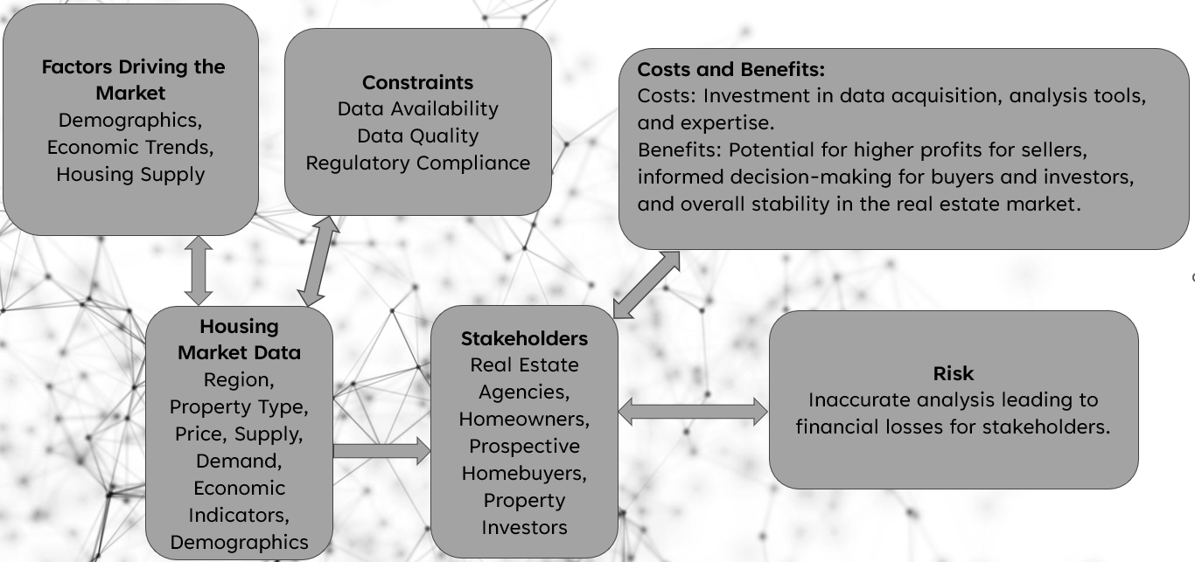
Conceptual Model

Slide 10
Objective:
The objective is to analyze trends in the housing market, particularly focusing on information on potential investment opportunities in different regions and types of properties.
Background:
Housing market experts believe there's a shift towards a seller's market due to increased demand and limited supply.
Factors contributing to increased demand include millennials entering the market as first-time buyers.
Both residential and commercial sectors are experiencing heightened demand.
Some experts speculate that this demand surge might be contributing to a housing crisis.
Canada is implementing measures like capping immigration to address potential housing issues.
Stakeholders:
Real estate agencies, Homeowners, Prospective homebuyers, Property investors

Slide 11
Success Criteria:
Ability to provide insights into factors driving the market (e.g., demographics, economic trends, housing supply).
Constraints:
Availability and quality of data: Ensuring access to reliable data sources for analysis.
Regulatory factors: Compliance with real estate regulations and laws.
Assumptions:
The analysis is based on 2023 housing prices listed on various websites, trends and may change depending on future economic and social developments.
Risks and Contingencies:
Risk: Inaccurate analysis leading to financial losses for stakeholders.
Contingency: Regular monitoring and updating of models based on new data and market changes.
Costs and Benefits:
Costs: Investment in data acquisition, analysis tools, and expertise.
Benefits: Potential for higher profits for sellers, informed decision-making for buyers and investors, and overall stability in the real estate market.

Slide 12
DATA Dictionary
Topic | Definition
Region | Refers to a geographical area within Canada, such as provinces, cities, or neighborhoods, where housing market data is collected and analyzed.
Property Type | Describes the category or classification of a property, such as single-family homes, condominiums, or commercial properties, which influences its market value and demand.
Demand | Refers to the level of interest or desire for properties in a specific region or property type, influenced by factors such as population growth, economic conditions, and buyer preferences.
Supply | Indicates the availability of properties for sale or rent within a given region or property type, impacting market dynamics, pricing, and competition among buyers and sellers.
Regulatory Compliance | Involves adherence to real estate regulations, laws, and ethical standards governing data collection, analysis, and reporting to ensure legality, transparency, and ethical conduct in the housing market.
Demographics | Encompasses the statistical characteristics of a population within a region, including age, income, household composition, and cultural diversity, which influence housing demand and market trends.

Slide 13
Data Understanding

Slide 14
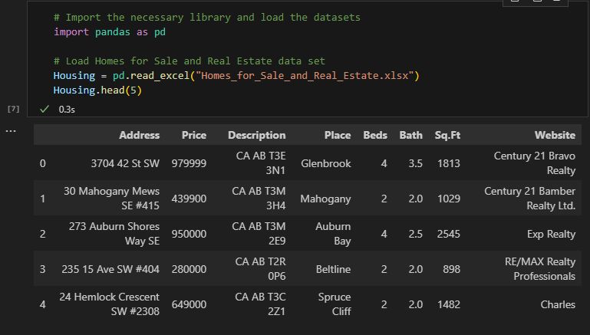
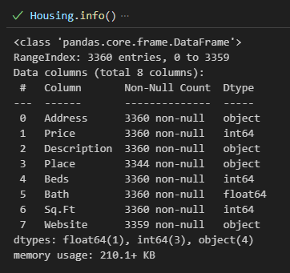
Data Understanding
Housing Price & Real Estate 2023:
Contains data on house listings, including price, geographic location, property type, and
additional features influencing housing value.

Slide 15
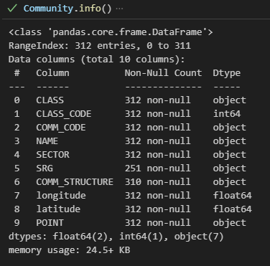
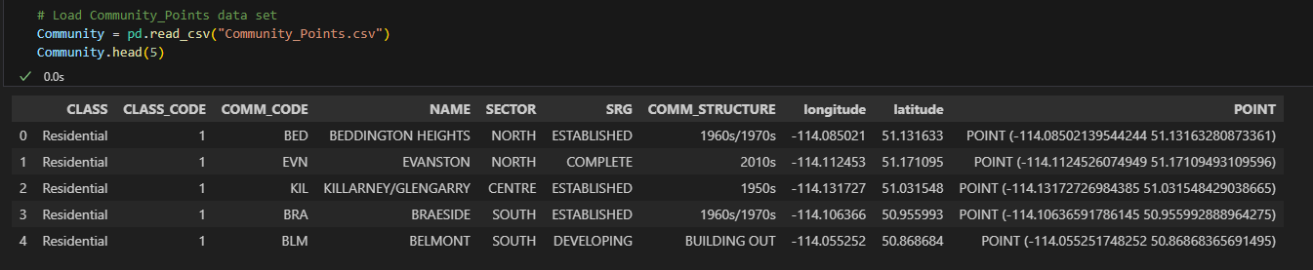
Data Understanding
Community Points:
Provides geographic and demographic data for communities, including centroids for precise location mapping, community structure, and developmental stage.

Slide 16
Data Preparation

Slide 17
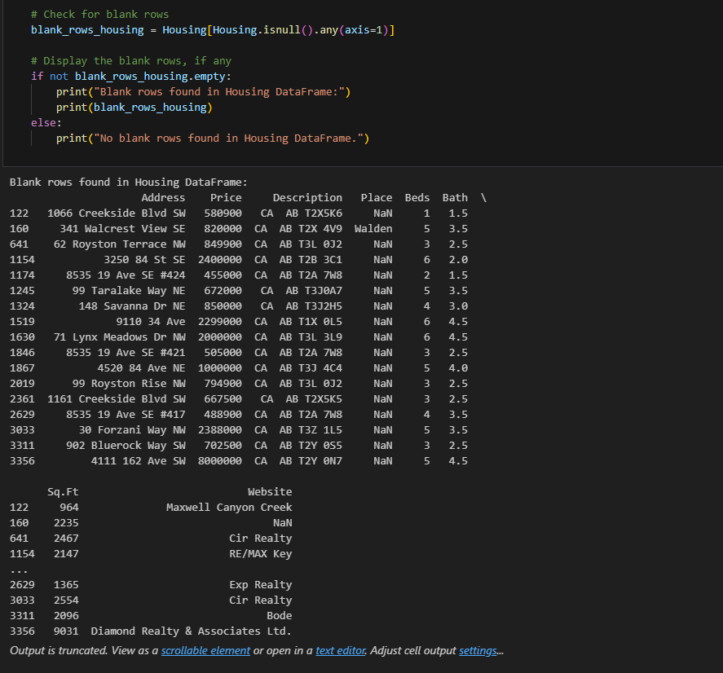
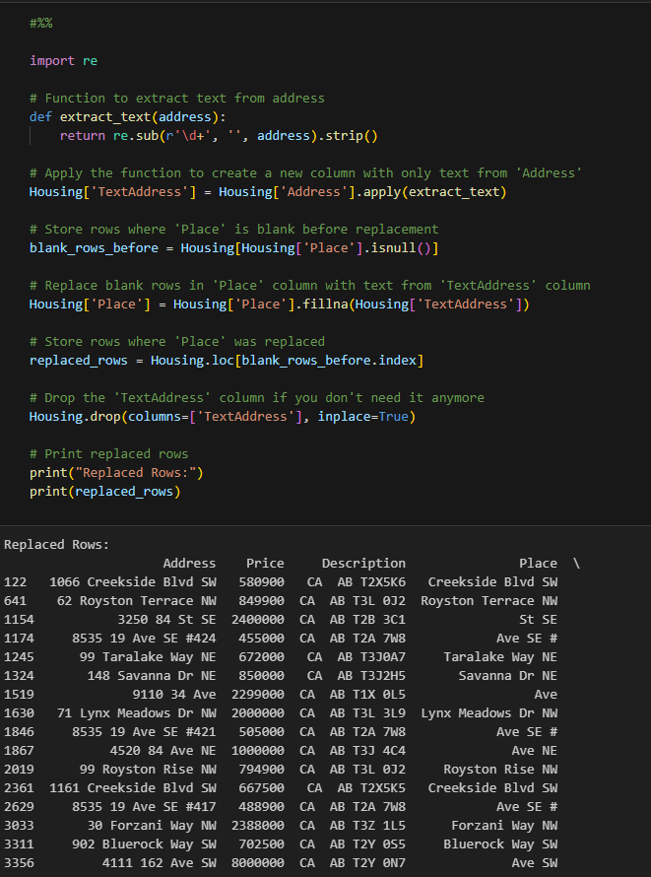
Data CLEANING

Slide 18
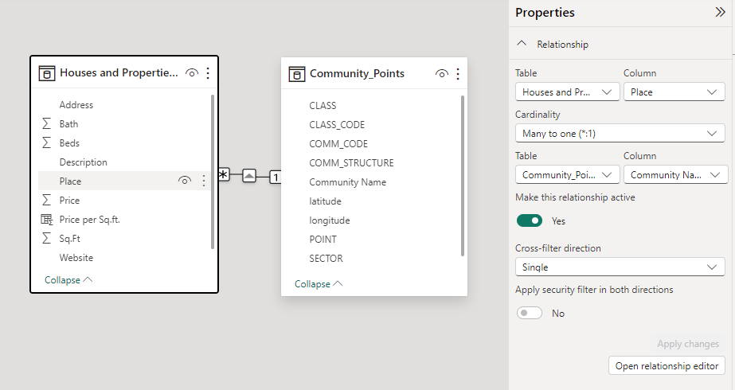
Data modeling

Slide 19
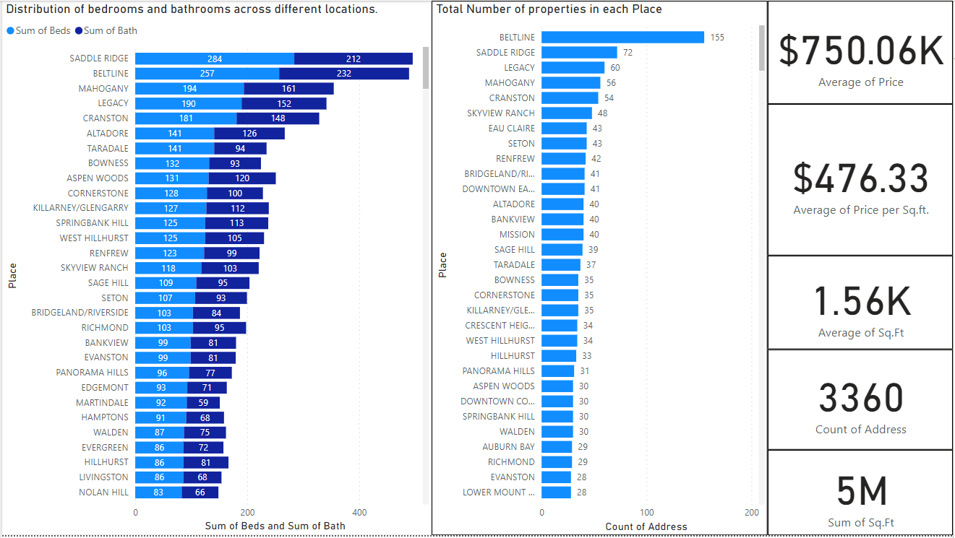
Data Analysis

Slide 20
Business Questions

Slide 21
Business Questions
What is the average price per square foot for homes in different communities, and how does it vary across sectors? And how does the community type (Industrial and Residential) influence the price of homes for sale?
In pursuit of investment opportunities, what type of property would be optimal in terms of maximizing the number of bedrooms? Additionally, in which community is such a property typically located, and what is the associated selling price?
For a single individual or a student with the financial means to purchase a property featuring one bedroom and one bathroom, what would be the anticipated cost of such a unit?

Slide 22
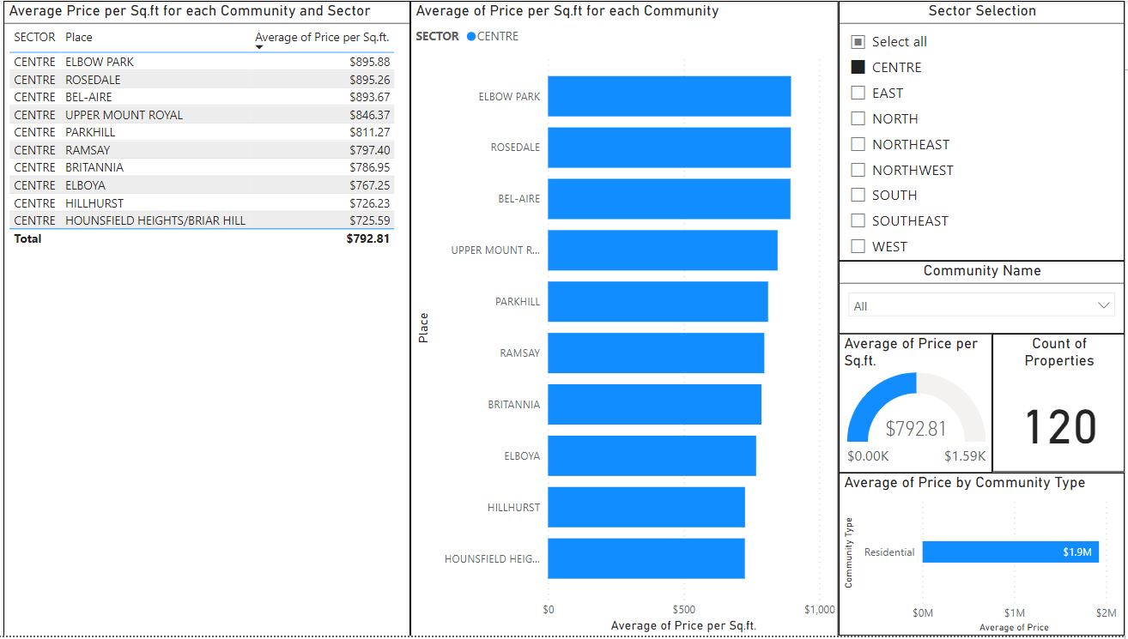
What is the average price per square foot for homes in different communities, and how does it vary across sectors? And how does the community type (Industrial and Residential) influence the price of homes for sale?
Top 10 in Centre Sector based on Average Price per Sq ft

Slide 23
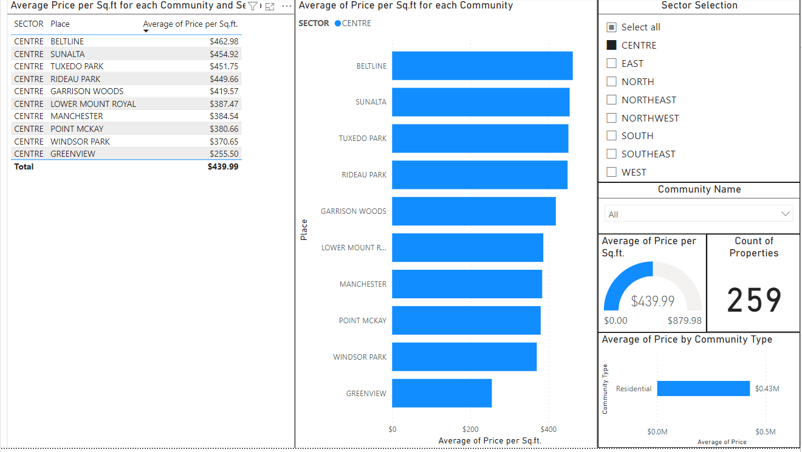
Bottom 10 in Centre Sector based on Average Price per Sq ft

Slide 24
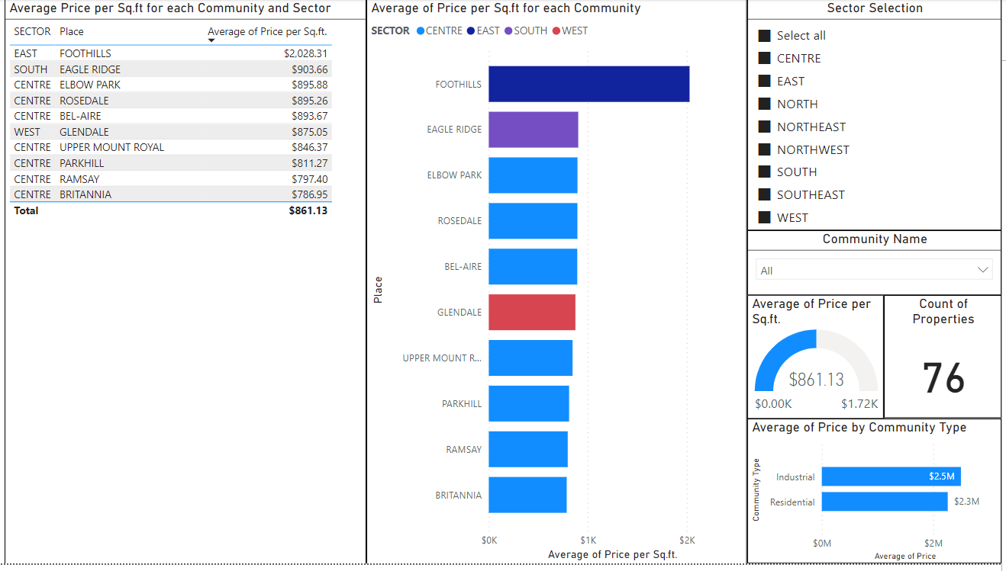
Top 10 across all Sector based on Average Price per Sq ft

Slide 25
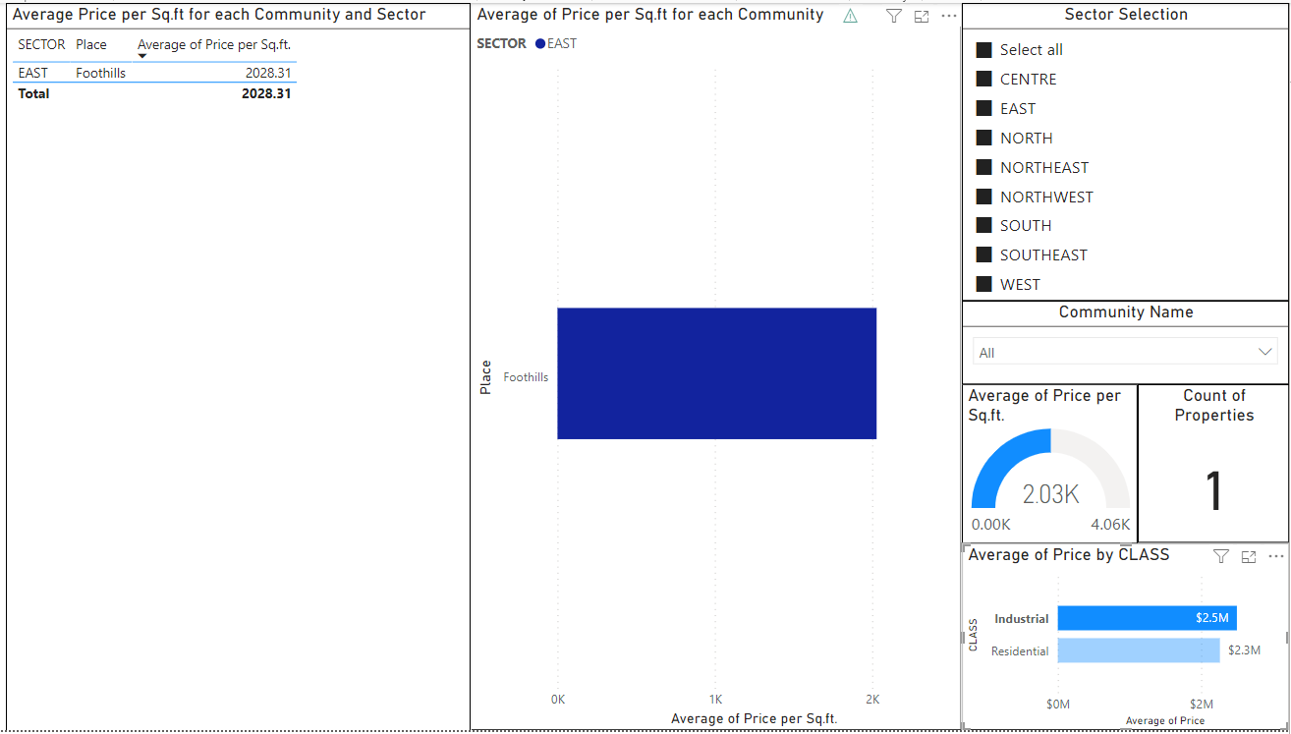
Industrial Class in Top 10 based on Average Price per Sq ft

Slide 26
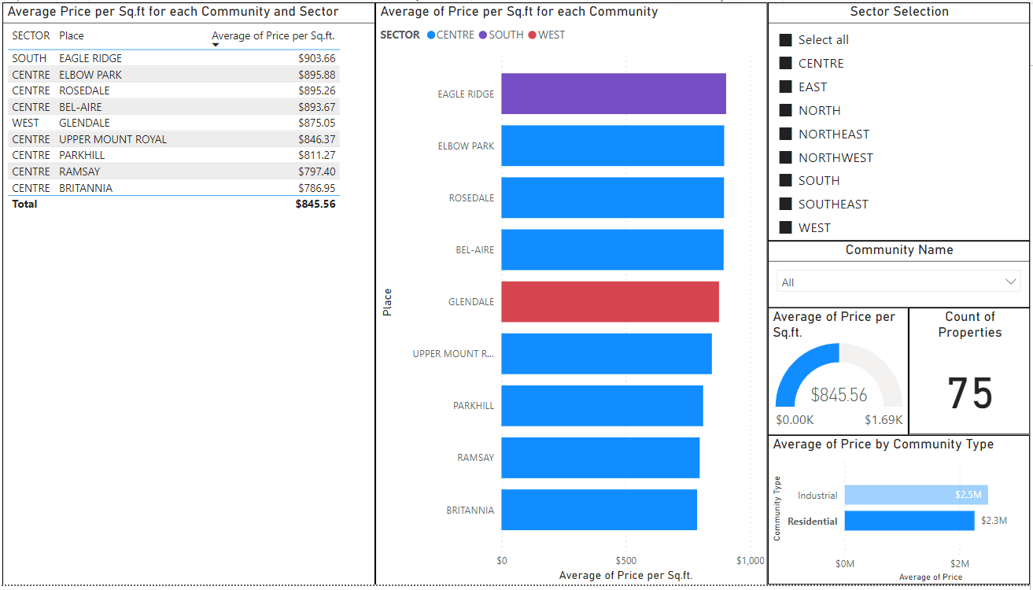
Residential Community Type in Top 10 based on Average Price per Sq ft

Slide 27
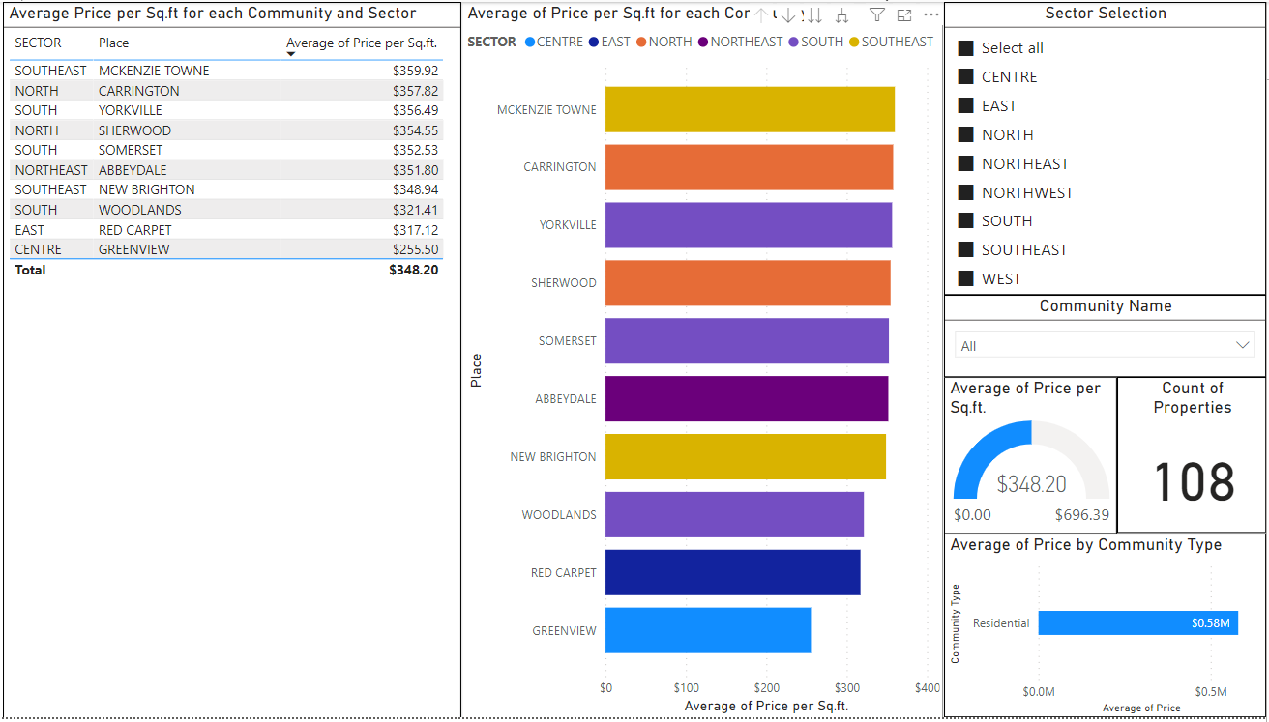
Bottom 10 across all Sector based on Average Price per Sq ft

Slide 28
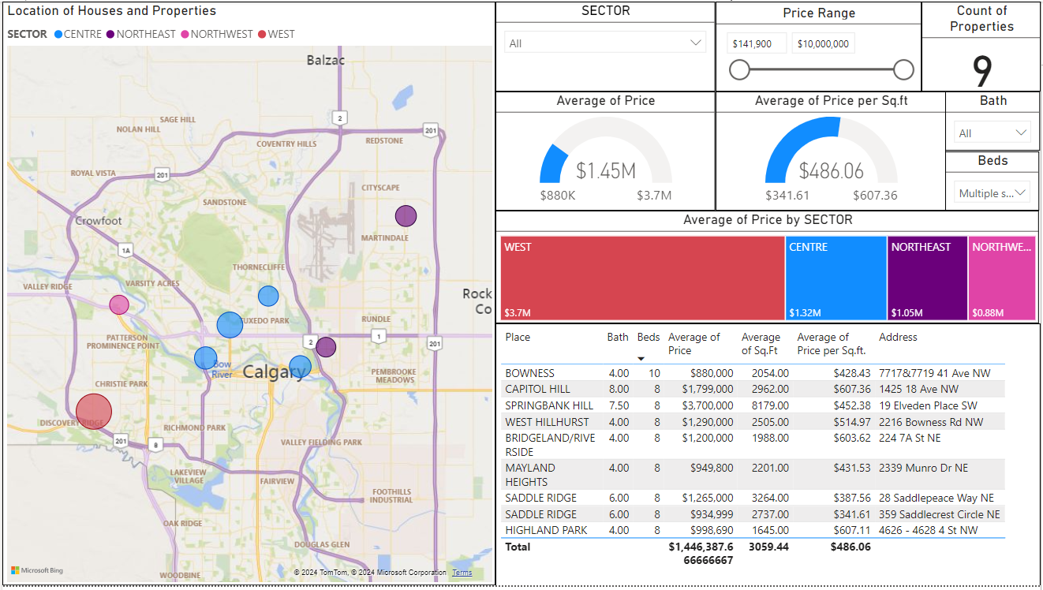
In pursuit of investment opportunities, what type of property would be optimal in terms of maximizing the number of bedrooms and Bathrooms? Additionally, in which community is such a property typically located, and what is the associated selling price?

Slide 29
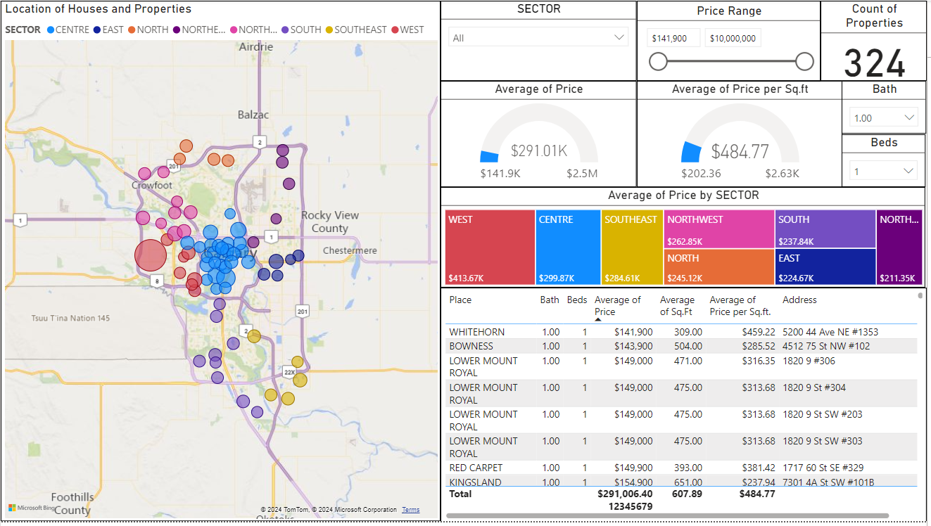
For a single individual with the financial means to purchase a property featuring one bedroom and one bathroom, what would be the anticipated cost of such a unit?

Slide 30
SUMMARY
In summary, the dashboard offers a detailed look at how home prices per square foot change in various communities and sectors, showing how community type influences these prices. Buyers can use this information to decide where to buy the type of property they're interested in, considering the average price per square foot and the total properties available in each community. This analysis is essential for making strategic decisions about investment or development in specific sectors.

Slide 31
Recommendations
Diversification of Investment Portfolio
Community-Level Analysis
Continuous Monitoring and Adaptation
Investment in Data Analytics
Improvement to Dataset
Reference
https://www.kaggle.com/datasets/reenapinto/housing-price-and-real-estate-2023
https://data.calgary.ca/Base-Maps/Community-Points/j9ps-fyst/data

Slide 32
THANK YOU

